Slide 1

Data Integration & Analysis
Data Team

Slide 2
Objectives
Aim
Integrate student marks data
Analyze trends by gender and subject
Summarize data using SQL & Databricks

Slide 3
Key Activities
Join and clean
Join and clean datasets
Identify patterns (e.g., gender vs marks)
Identify

Slide 4
Key Findings
Females scored higher in Reading and Writing
Males performed better in Math
Test preparation course improves scores

Slide 5

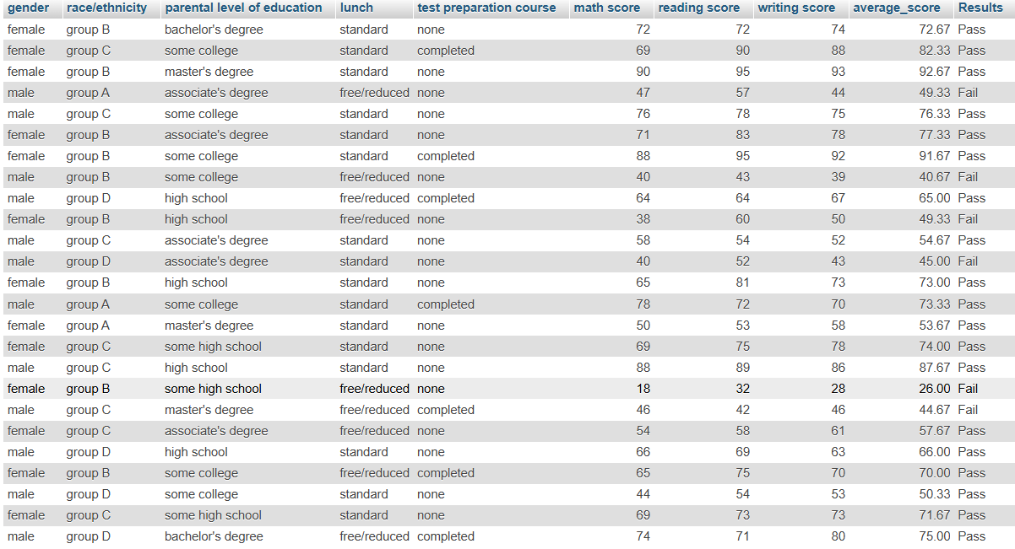
Deliverables
Integrated dataset completed
Insightful summary tables created
visualizations

Slide 6
Next Steps
Build Looker Studio dashboard
Include filters (gender, subject, test preparation)
Finalize and present insights

Slide 7

Closing
Question Answers?

